Slide 1
软件工程原理与实践
Software Engineering
软件工程模型和方法

Slide 2
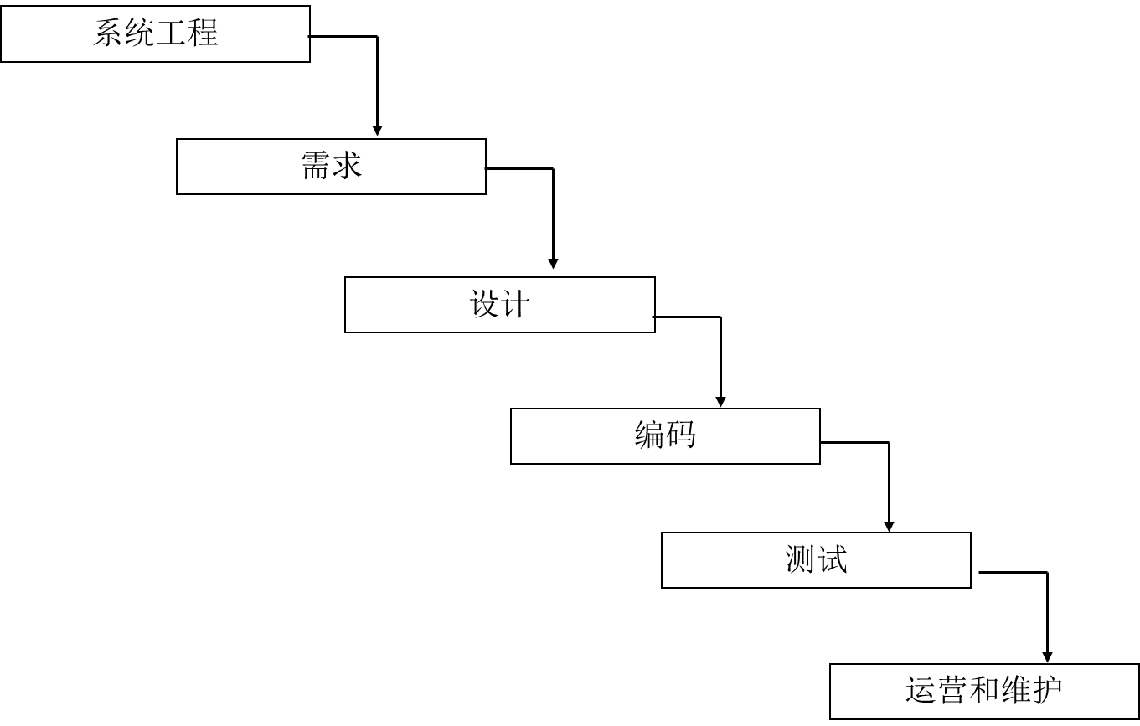
软件建模是软件工程的核心技术
人
技术
管理
过程

Slide 3
01-什么是模型
02-软件建模方法
03-面向对象方法概述
@第3章.教材

Slide 4

思考
什么是模型？
为什么要建模？
软件模型有哪几种？

Slide 5

波音747
超过6百万个零件，仅机尾就有上百个零件
能承载上百个旅客
能不停地飞行上千公里

Slide 6
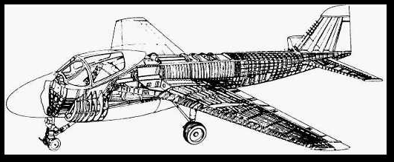
波音747
当波音在60年代开始生产747的时候，一共画了75，000张工程图
为什么？
因为他们正在生产一个极其复杂的系统，
而且不能出哪怕是一点点的差错

Slide 7
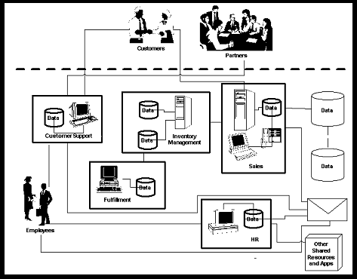
软件开发也同样复杂
人与系统的交互
系统安全
交易，存储
模型
可靠性，可扩展性
子系统，模块，
分布式
成千上万行程序

Slide 8
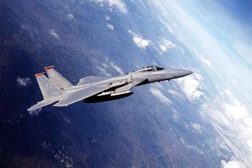
什么是模型?
A model is a simplification of reality.

Slide 9
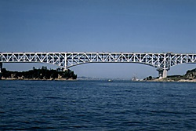
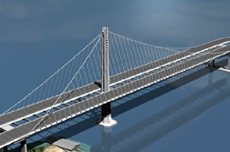
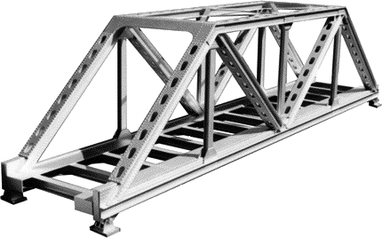
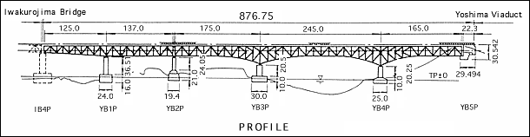
工程师们这样做…
他们在建造实际的物体之前...
…首先建立模型
…然后在模型的基础上进行研究和改进
❒
✓
❒

Slide 10
模型的功能
在正式启动工程项目之前发现设计中的错误和遗漏之处
  通过(形式化的)分析和实验，降低工程的风险
研究和比较不同的解决方案
用来和项目的所有者进行交流
  客户、用户、实现者、测试者、开发文档管理员，等等.
促进工程的实现

Slide 11
建模的重要性
Less Important
More Important
Paper Airplane
Fighter Jet
Notes:
Emphasize that complex projects outside of the software industry require models.
It’s inconceivable that a defense contractor would build an airplane as complex as a fighter jet without modeling the airplane first. Why? Because unlike building paper airplanes, the cost of failure is significant.
As a general rule, modeling becomes more important as the complexity and expense rises.

Slide 12
有用模型的特征
抽象性
  突出重点方面，去除无关紧要的细节
可理解性
  模型的表达方式能被模型的观察者很容易地理解
精确性
  忠实地表达被建模的系统
说明性
  能够被用来对被建模系统进行直观地分析，并得出正确的结论
经济性
  模型的建立和分析比被建模系统更廉价，更经济
作为有用的工程模型, 必需具备以上所有特征!

Slide 13
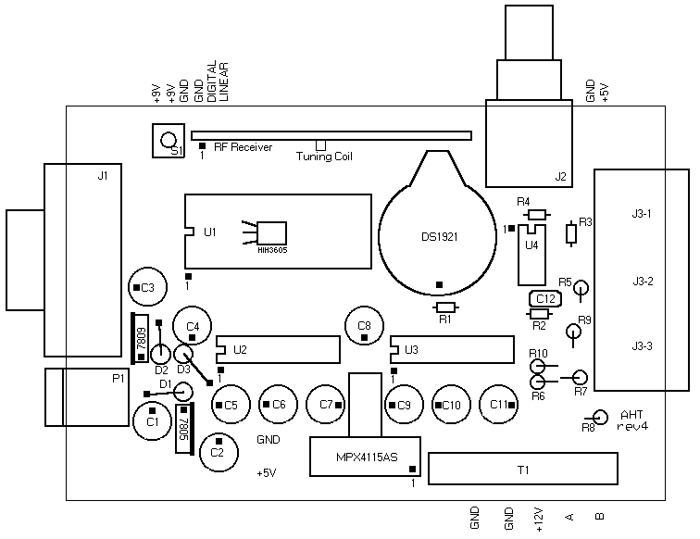
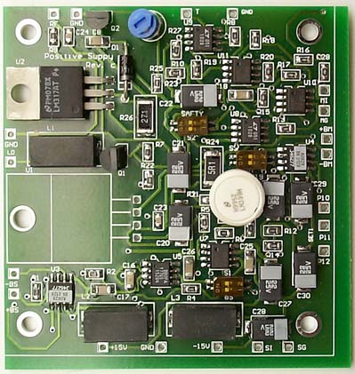
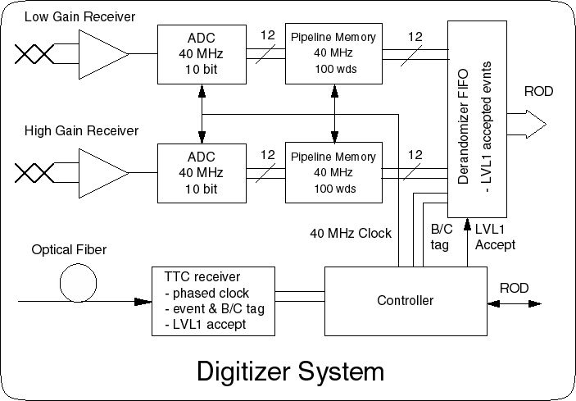
模型的多个视图
物理布局
视图
功能
视图

Slide 14
举例：UML 的软件模型视图
这些视图相互集成
需求:
  用例图 Use Case diagram
结构:
  本体论: 类图 Class diagram
  实 例: 对象图 Object diagram
行为
  状态图 Statechart diagram
  活动图 Activity diagram
  交 互：顺序图和协作图 Sequence diagram & Collaboration diagram
实现:
  构件图 Component diagram
  部署图 Deployment diagram
构成一个完整的模型

Slide 15
软件的三种模型
Computation-
Independent
Model (CIM)
More Abstract
Platform-
Independent
Model (PIM)
Platform-
Specific
Model (PSM)
More Specific

Slide 16

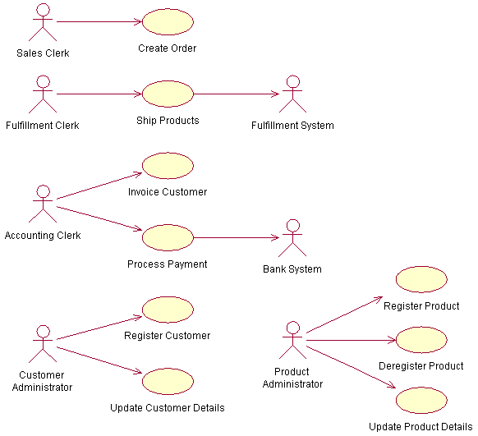
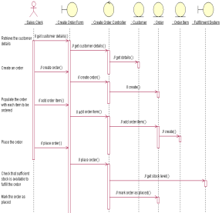
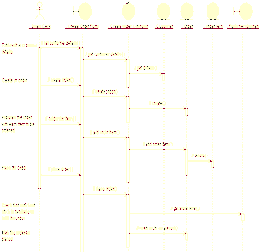
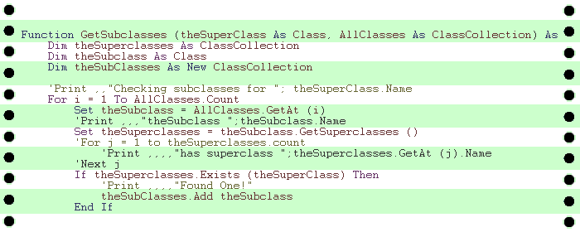
模型间的转换
计算无关模型
CIM
业务模型
平台无关模型
PIM
分析模型
平台有关模型
PSM
设计模型
代码
实现模型
系统工程
需求
设计
编码
测试
测试模型

Slide 17
01-什么是模型
02-软件建模方法
03-面向对象方法概述

Slide 18
软件建模的方法
结构化方法 (Structured Method)
面向对象方法 (Object Oriented Method)
基于构件的软件开发方法 (Component Based Software Development)
面向服务方法 ( Service Oriented Method)
模型驱动的开发方法 (Model-Driven Development)
形式化方法 (Formal Method)
……

Slide 19
结构化方法
核心: 数据和处理
手段: 自顶向下，逐步求精、模块化
常用建模工具:
  需求建模：
    DFD(数据流图)
    DD(数据字典)
    ERD(实体关系图)：ER模型，数据建模
    STD(状态转换图)：例如操作系统中进程之间的转换
  设计建模：
    结构图（SC）：功能模块结构图
    流程图、 N-S图、PAD图、伪代码：程序流程图等

Slide 20
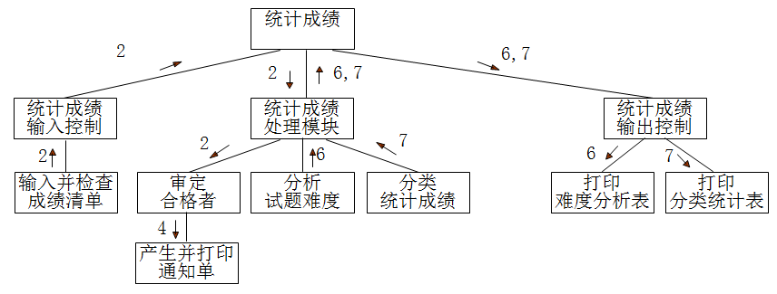
结构化设计的系统示例

Slide 21
面向对象方法
面向对象方法是九十年代以来的主流开发方法
  符合人们对客观世界的认识规律
  开发的系统结构易于理解易于维护
  继承机制能够有力支持软件复用
常见的面向对象方法
  Booch method 1994
  Coad and Yourdon method 1991
  Rambaugh method -- OMT 1991
  Jacobson method – OOSE 1992
  Wirfs-Brock method 1990
  ……
  国际标准统一建模语言 UML 1997

Slide 22
面向对象方法示例：销售订单
Order
Product
Ship via

Slide 23
销售订单的类图
Sale
seller
buyer
item sold
shipping mechanism
Salesperson
Customer
Product
Vehicle
Corporate
Individual
Truck
Train

Slide 24
需求变更的影响
假定你需要增加新的运输工具 ...
Sale
seller
buyer
item sold
shipping mechanism
Salesperson
Customer
Product
Vehicle
Corporate
Individual
Truck
Train
Airplane
增加一个新的子类

Slide 25
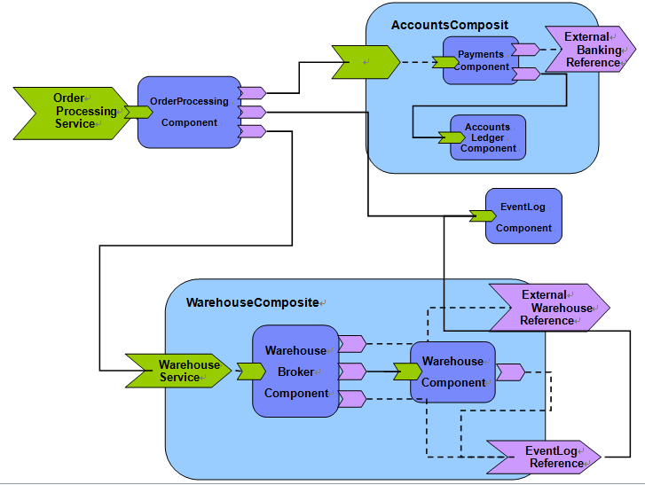
基于构件的软件系统示例

Slide 26
构件
构件是软件复用的重要手段，是核心和基础
构件由构件规约与构件实现两部分组成
Component interface
Component implementation

Slide 27
基于构件的开发
A3
R
A1
A4
A2
基础构件
A
B
C
D
D
B2
B4
B1
B3
A1
B1
A1
A2
B1
B2
C2
C1
D1
功能构件
C1
A2
C1
C2
B2
应用系统
A3
A4
B3
B4
D2
应用构架库
接口构件
应用系统
D1
D2
组装车间
应用构架
提取车间
界面构件
构件库
构件生产车间
标准规范 与 质量保证

Slide 28
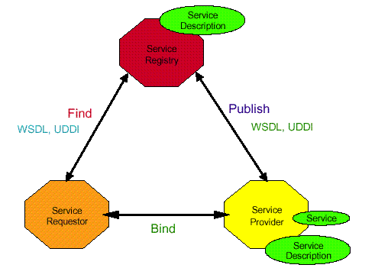
面向服务的方法
面向服务的架构(Service-Oriented Architecture, SOA)是一种软件开发方法，使用称为服务的软件组件来创建业务应用程序
将应用程序的功能划分为独立的服务，这些服务通过标准化的接口进行交互
每个服务是一个独立的功能模块，完成特定业务任务，并可以被其他服务重用
面向服务的架构包含四个主要组件
  服务（Service）：服务实施（代码）、服务合同、服务接口
  服务提供商（Service Provider）
  服务使用者（Service Requestor）
  服务注册表（Service Registry）：服务存储库

Slide 29
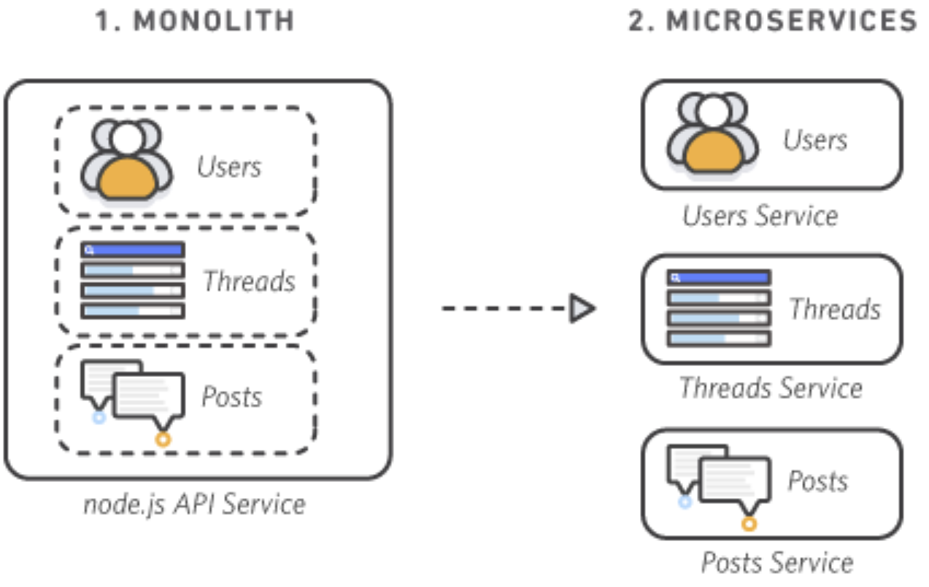
面向服务的方法
SOA的基本原则
服务的抽象性（基于接口的编程）
服务的自治性（实现分布式应用）
服务间的松耦合式绑定，基于标准化消息进行通信
服务的自描述性（支持动态发现与延迟绑定）
服务的粗粒度（支持基于业务逻辑的积木式装配）
SOA中服务使用确定网络数据传输的既定规则进行通信，即通信协议：
简单对象访问协议（SOAP）
RESTful HTTP
Apache Thrift
Apache ActiveMQ
Java Message Service（JMS)

Slide 30
面向服务的方法——微服务
微服务(微服务架构)是SOA的一种变体，是一种云原生架构方法
在单个应用中包含中多松散耦合且可单独部署的小型组件或服务
这些服务拥有自己的技术栈，包括数据库和数据管理模型
通过一个REST API、事件流和消息代理组合彼此通信
微服务架构最适合现代云计算环境，通常在容器中运行
微服务与SOA的比较：
微服务使软件与基于云的现代企业环境更加兼容
微服务中的服务完全独立，通过轻量级 API 访问自己的通信协议
消除了SOA对集中式ESB（Enterprise Service Bus，企业服务总线）的需求，使用者通过微服务的 API 使用微服务

Slide 31
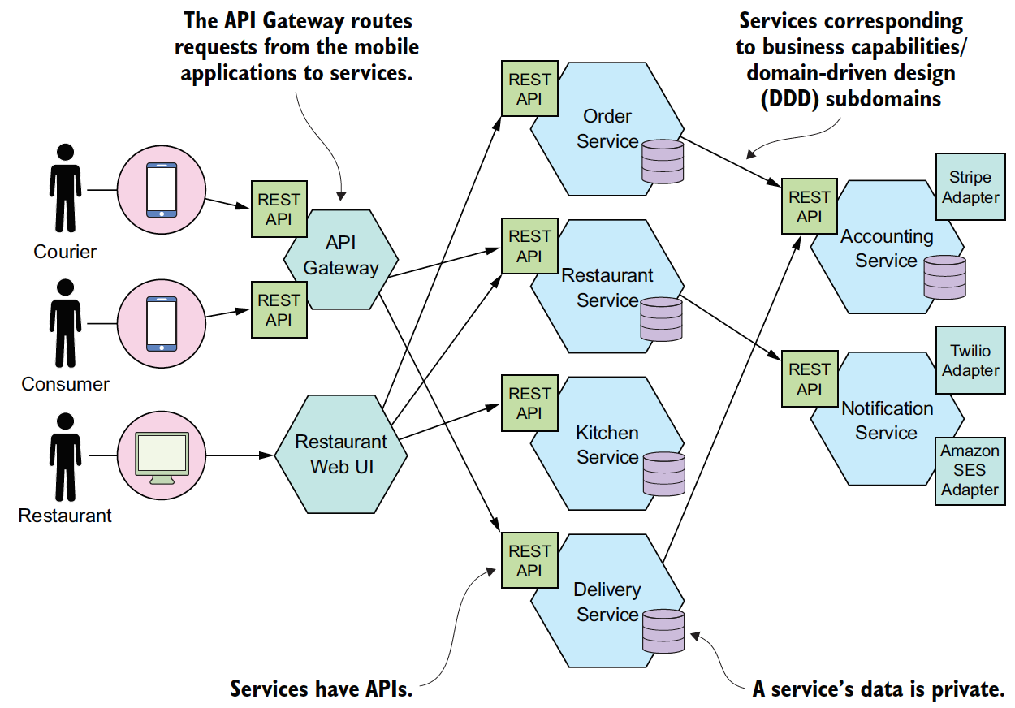
面向服务的系统示例 (基于微服务架构的网络订餐系统）

Slide 32

模型驱动的软件开发 (MDD)
以模型为中心（相对于以代码为中心）的软件开发方法
基于以下两种久经考验的技术
(1) 抽象
(2) 自动化
«sc_module»
producer
«sc_module»
producer
建模语言
start
out1
start
out1
建模工具
SC_MODULE(producer)
{sc_inslave<int> in1;
int sum; //
void accumulate (){
sum += in1;
cout << “Sum = “ << sum << endl;}
SC_MODULE(producer)
{sc_inslave<int> in1;
int sum; //
void accumulate (){
sum += in1;
cout << “Sum = “ << sum << endl;}

Slide 33
模型间的(半)自动转换
计算无关模型
CIM
业务模型
平台无关模型
PIM
分析模型
平台有关模型
PSM
设计模型
代码
实现模型
系统工程
需求
设计
编码
测试
测试模型

Slide 34
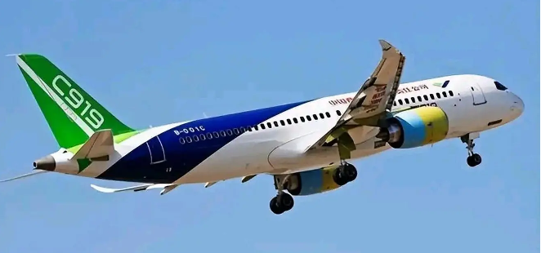
形式化方法
形式化方法是基于数学的技术开发软件，如集合论、模糊逻辑、函数。
形式化方法的好处：
  无二义性
  一致性
  正确性
  完整性
形式化验证
形式化开发
国产替代
安全可信

Slide 35
举例
--------AddBlock-----------------
△BlockHandler
Ablocks？： P BLOCKS
---------------------------------
Ablocks？⊆ used
BlockQueue'=BlockQueue⌒〈Ablocks？〉
used'=used∧
free'=free
加一个块集合到队列的尾部, 采用Z语言

Slide 36
形式化方法的不足
形式化规约主要关注于功能和数据，而问题的时序、控制和行为等方面却更难于表示。此外，有些问题元素(如，人机界面)最好用图形技术来刻划。
使用形式化方法来建立规约比其他方法更难于学习，并且对某些软件实践者来说它代表了一种重要的“文化冲击”。
难以支持大的复杂系统。
尚未成为主流的开发方法，实践和应用较少

Slide 37
Review：软件建模的方法
结构化方法 (Structured Method)
面向对象方法 (Object Oriented Method)
基于构件的软件开发方法 (Component Based Software Development)
面向服务方法 ( Service Oriented Method)
模型驱动的开发方法 (Model-Driven Development)
形式化方法 (Formal Method)
……

Slide 38
01-什么是模型
02-软件建模方法
03-面向对象方法概述

Slide 39
面向对象的方法（Object-Oriented，OO）
OO强调通过对象来模拟现实世界中的实体和行为，使得软件的开发方法与过程尽可能接近人类认识世界、解决现实问题的方法和过程
‌OO‌是一种程序设计范型和开发方法，它将现实世界的事物抽象成对象和‌类，通过‌封装、‌继承和‌多态等机制，实现对现实世界的抽象与数字建模
面向对象系统由相互交互的对象组成，这些对象保持自己的本地状态同时基于状态提供相应的操作
面向对象设计过程包括：
设计类以及这些类之间的关系
Notes:
一个面向对象系统由相互交互的对象组成，这些对象保持自己的本地状态同时基于状态提供相应的操作。
状态的表示是私有的，无法从该对象的外部直接访问。
面向对象设计过程包括：设计类以及这些类之间的关系。
开发一个系统设计（从概念到详细的面向对象设计），需要：
1. 理解并定义上下文以及与系统的外部交互；
2. 设计系统体系结构；
3. 识别系统中的主要对象；
4. 刻画接口。
Provide a high-level definition of object technology. Keep in mind that this is all new to most of your students.
Share with the students your excitement about OO. Object technology is not simply the use of an object-oriented language like Java or C++. It is based on the principles of abstraction, modularity, hierarchy, and encapsulation.
If an organization is to successfully implement object technology, they must use more than a language. They must also use process, a modeling language (UML), data modeling techniques, and so on.

Slide 40
对象技术
What Is Object Technology?
  A set of principles (抽象abstraction, 封装encapsulation, 多态polymorphism) guiding software construction, together with languages, databases, and other tools that support those principles.
The Strengths of Object Technology
  Reflects real world models more closely
  Reflects a single paradigm
  Facilitates architectural and code reuse
  Encourages stability
  Is adaptive to change
Notes:
一个面向对象系统由相互交互的对象组成，这些对象保持自己的本地状态同时基于状态提供相应的操作。
状态的表示是私有的，无法从该对象的外部直接访问。
面向对象设计过程包括：设计类以及这些类之间的关系。
开发一个系统设计（从概念到详细的面向对象设计），需要：
1. 理解并定义上下文以及与系统的外部交互；
2. 设计系统体系结构；
3. 识别系统中的主要对象；
4. 刻画接口。
Provide a high-level definition of object technology. Keep in mind that this is all new to most of your students.
Share with the students your excitement about OO. Object technology is not simply the use of an object-oriented language like Java or C++. It is based on the principles of abstraction, modularity, hierarchy, and encapsulation.
If an organization is to successfully implement object technology, they must use more than a language. They must also use process, a modeling language (UML), data modeling techniques, and so on.

Slide 41
The History of Object Technology
Major object technology milestones
Simula
C ++
UML
Future
1967
Late 1980s
1996
1972
1991
2003
???
Smalltalk
Java
MDA
(Model Driven Architecture)
Notes:
Review these milestones with the students so that they garner a perspective on object technology’s history.
This slide was included to show students that object technology is not new. It has been around for a long time and is a proven and fairly mature technology.

Slide 42

UML （Unified Modeling Language)
UML 2.5
(2017)
UML 2.0
(2003)
UML
Partners’
Expertise
UML 1.0
(Jan. ‘97)
UML 0.9
(June ‘96)
and
UML 0.91
(Oct. ‘96)
Public
Feedback
Unified Method 0.8
(OOPSLA ’95)
Booch ’93
OMT - 2
Other
Methods
OOSE
Booch ‘91
OMT - 1

Slide 43
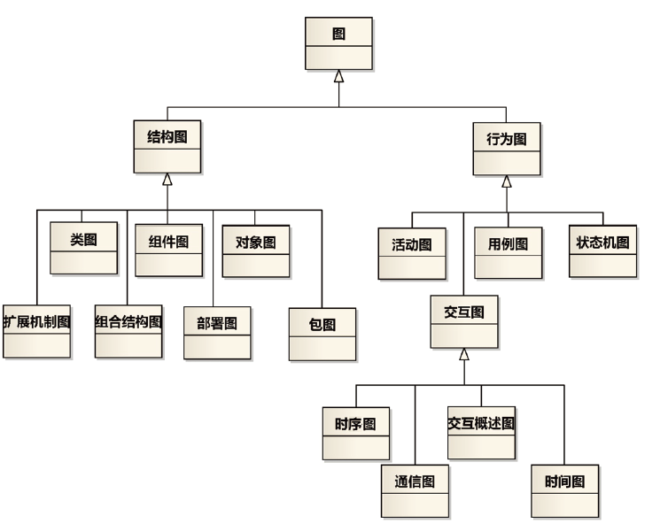
UML模型
Multiple views
Precise syntax and semantics
Notes:
The UML provides a graphical language for representing models but provides little or no guidance on when and how to use these diagrams. This is an area in which the RUP helps. It describes the kinds of project artifacts needed, including diagrams, and puts them in the context of an overall project plan.

Slide 44
UML建模工具
IBM Rhapsody 和RSA
Sparx Systems EA
Sybase PowerDesigner
Borland Together
Microsoft Visio
StarUML 开源
ArgoUML 开源
…

Slide 45
Where Is Object Technology Used?
C/S和B/S架构软件开发 Client/Server Systems and Web Development
实时系统 Real-time Systems
嵌入式系统 Embedded System
多媒体系统 Multimedia System
中间件 Middleware
……
Notes:
Demonstrate that object technology is used in many client/server applications today.
If you have a “war-story” or an experience that you had working on a Web or client-server application that successfully used object technology, share it here.
This is not just for traditional 2-tier client/server systems, but also N-tier systems such as large scale Web applications.

Slide 46
What Is an Object?
Informally, an object represents an entity, either physical, conceptual, or software.
  Physical entity
  物理实体
  Conceptual entity
  概念实体
  Software entity
  软件实体
Truck
Chemical Process
Linked List
Notes:
Stress that objects can represent anything. Remember, most of your students do not know what an object is.

Slide 47
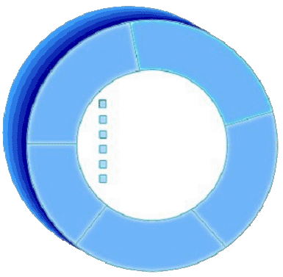
A More Formal Definition
An object is an entity with a well-defined boundary and identity that encapsulates state and behavior.
  State is represented by attributes and relationships.
  Behavior is represented by operations, methods, and state machine
Attributes
Object
Operations
Notes:
Emphasize that state, identity and behavior are the key characteristics of an object.
Take a moment to explain the graphic on this slide.
Attributes are documented on the inside of the doughnut.
Operations are documented on the borders, which become clearer to the student as you discuss topics like encapsulation.
Note that the doughnut is not part of the UML notation. UML notation is discussed later.

Slide 48
Representing Objects in the UML
An object is represented as a rectangle with an underlined name.
J Clark :
Professor
Named Object
: Professor
Professor J Clark
Anonymous Object
Notes:
Demonstrate how an object is modeled in UML.
Many of your students may now wonder, “Hey, what is a class?” Classes are defined on the next slide.

Slide 49
Basic Principles of Object Orientation
面向对象的原则：
抽象
封装
模块化
层次化
…
Object Orientation
Abstraction
Encapsulation
Modularity
Hierarchy
Notes:
Introduce the four basic principles of OO.
Be sure the students understand objects before you begin this next section.
You’ve introduced objects first to help students better apply each of these principles.

Slide 50
What Is Abstraction? 抽象
The essential characteristics of an entity that distinguishes it from all other kinds of entities.
Defines a boundary relative to the perspective of the viewer.
Is not a concrete manifestation, denotes the ideal essence of something.
Course Offering (9:00 a.m.,
Monday-Wednesday-Friday)
Student
Professor
Course (e.g. Algebra)
Notes:
Explain the concept of abstraction to the students.
A car (“a mobile, powered vehicle for transporting people from place to place”) is an example of an abstraction if it suppresses less important details.
The abstract use of car is not concrete. However, if you describe the car as a 1995 Blue Ford Mustang, then it becomes a concrete manifestation and not an abstraction.
Discuss the makings of a good abstraction.
Concise
Single coherent concept
Abstraction removes the unnecessary details to make something easier to understand.

Slide 51
What Is Encapsulation? 封装
Hides implementation from clients.
  Clients depend on interface.
Improves Resiliency
Notes:
Define the concept of encapsulation to the students.
Encapsulation is putting the “data bits” and operations that manipulate them in the same place.
Encapsulation does NOT allow direct manipulation of things that have been encapsulated without using the supplied interface.
An example is a car’s accelerator. Generally speaking, you put your foot down and the car goes faster. You don’t worry about the cables, electronics, engine, and the rest.

Slide 52
Encapsulation Illustrated
Professor Clark needs to be able to teach four classes in the next semester.
Professor Clark
AcceptCourseOffering()
SubmitFinalGrades()
Name: J Clark
Employee ID: 567138
HireDate: 07/25/1991
Status: Tenured
Discipline: Finance
MaxLoad:4
SetMaxLoad(4)
SetMaxLoad()
TakeSabbatical()
Notes:
Point out that the requesting object does not need to know the structure of the Professor object to request a state change.
The object that owns the attributes is the only one allowed to change its own attributes.
Note that encapsulation can also be illustrated using interfaces. However, the scope of this course does not include this discussion.

Slide 53
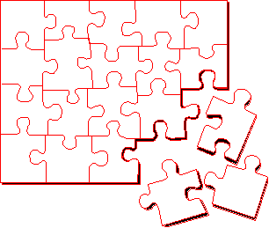
What Is Modularity? 模块化
Breaks up something complex into manageable pieces.
Helps people understand complex systems.
Notes:
Explain the concept of modularity to the students.
Modularity supports a separation of concerns.

Slide 54
Example: Modularity
For example, break complex systems into smaller modules.
Billing
System
Course
Catalog
System
Course Registration System
Student
Management
System
Notes:
A car is an example of modularity. It is made of up of a body, chassis, engine, wheels, and so on.

Slide 55
What Is Hierarchy? 层次
Increasing
abstraction
Asset
BankAccount
Security
RealEstate
Decreasing
abstraction
Savings
Checking
Stock
Bond
Elements at the same level of the hierarchy should be at the same level of abstraction.
Notes:
Explain the concept of hierarchy to the students.
Hierarchy is a taxonomic organization. The use of hierarchy makes it easy to recognize similarities and differences.
A taxonomic organization is one that represents an orderly classification. For example, plants and animals are classified taxonomically.
Note that this is not part of the UML notation. UML notation is discussed later.

Slide 56
What Is a Class? 类
A class is a description of a set of objects that share the same attributes, operations, relationships, and semantics. （相同的属性、操作、关系、语义）
  An object is an instance of a class. （对象是类的实例）
A class is an abstraction in that it （类本身就是一种抽象）
  Emphasizes relevant characteristics.
  Suppresses other characteristics.
Notes:
Explain what a class is to the students. Remember, many of your students are not familiar with this term.
The course introduces objects before classes because objects are the things that actually do most of the work. Classes are the templates for the objects.

Slide 57
Representing Classes in the UML
A class is represented using a rectangle with three compartments:
  The class name
  The structure (attributes)
  The behavior (operations)
类的实现
  Class Professor
  属性：用变量实现
  操作：用方法实现
Professor
- name
Visibility:
  Public: +
  Private: -
  Protected: #
- employeeID : UniqueId
- hireDate
- status
- discipline
- maxLoad
+ submitFinalGrade()
+ acceptCourseOffering()
+ setMaxLoad()
+ takeSabbatical()
+ teachClass()
Notes:
Demonstrate how a class is modeled in UML.
Tell them that the UML represents public visibility with a plus (+) symbol and private visibility with a minus (-) symbol. Do not discuss protected visibility.

Slide 58
The Relationship between Classes and Objects
A class is an abstract definition of an object.
  It defines the structure and behavior of each object in the class.
  It serves as a template for creating objects.
Classes are not collections of objects.
Professor
Professor Torpie
Professor Meijer
Professor Allen
Notes:
Show how classes and objects are related.
Classic example: A class is to an object what a cookie cutter is to a cookie.

Slide 59
What Is a Package? 包
A general purpose mechanism for organizing elements into groups.
A model element that can contain other model elements.
A package can be used:
  To organize the model under development.
  As a unit of configuration management. （用于配置管理的单元）
模块化
University
Artifacts
Notes:
Introduce the term package to the students.
A package is a “virtual bag.” You can place just about anything inside of it that you would like.
Packages allow us to organize our models into bits and pieces that make sense. They support the concept of modularity.

Slide 60
Package 示例
The package, University Artifacts, contains one package and five classes.
Student
Artifacts
Professor
University
Artifacts
Course
Schedule
Student
CourseOffering
Notes:
Explain how packages and classes are related to one another.
Make sure students understand that packages are a higher level of abstraction than a class.
Everything in your model must reside in a package. Therefore, it is assumed that, at the top level of your model, there is one owning package.

Slide 61
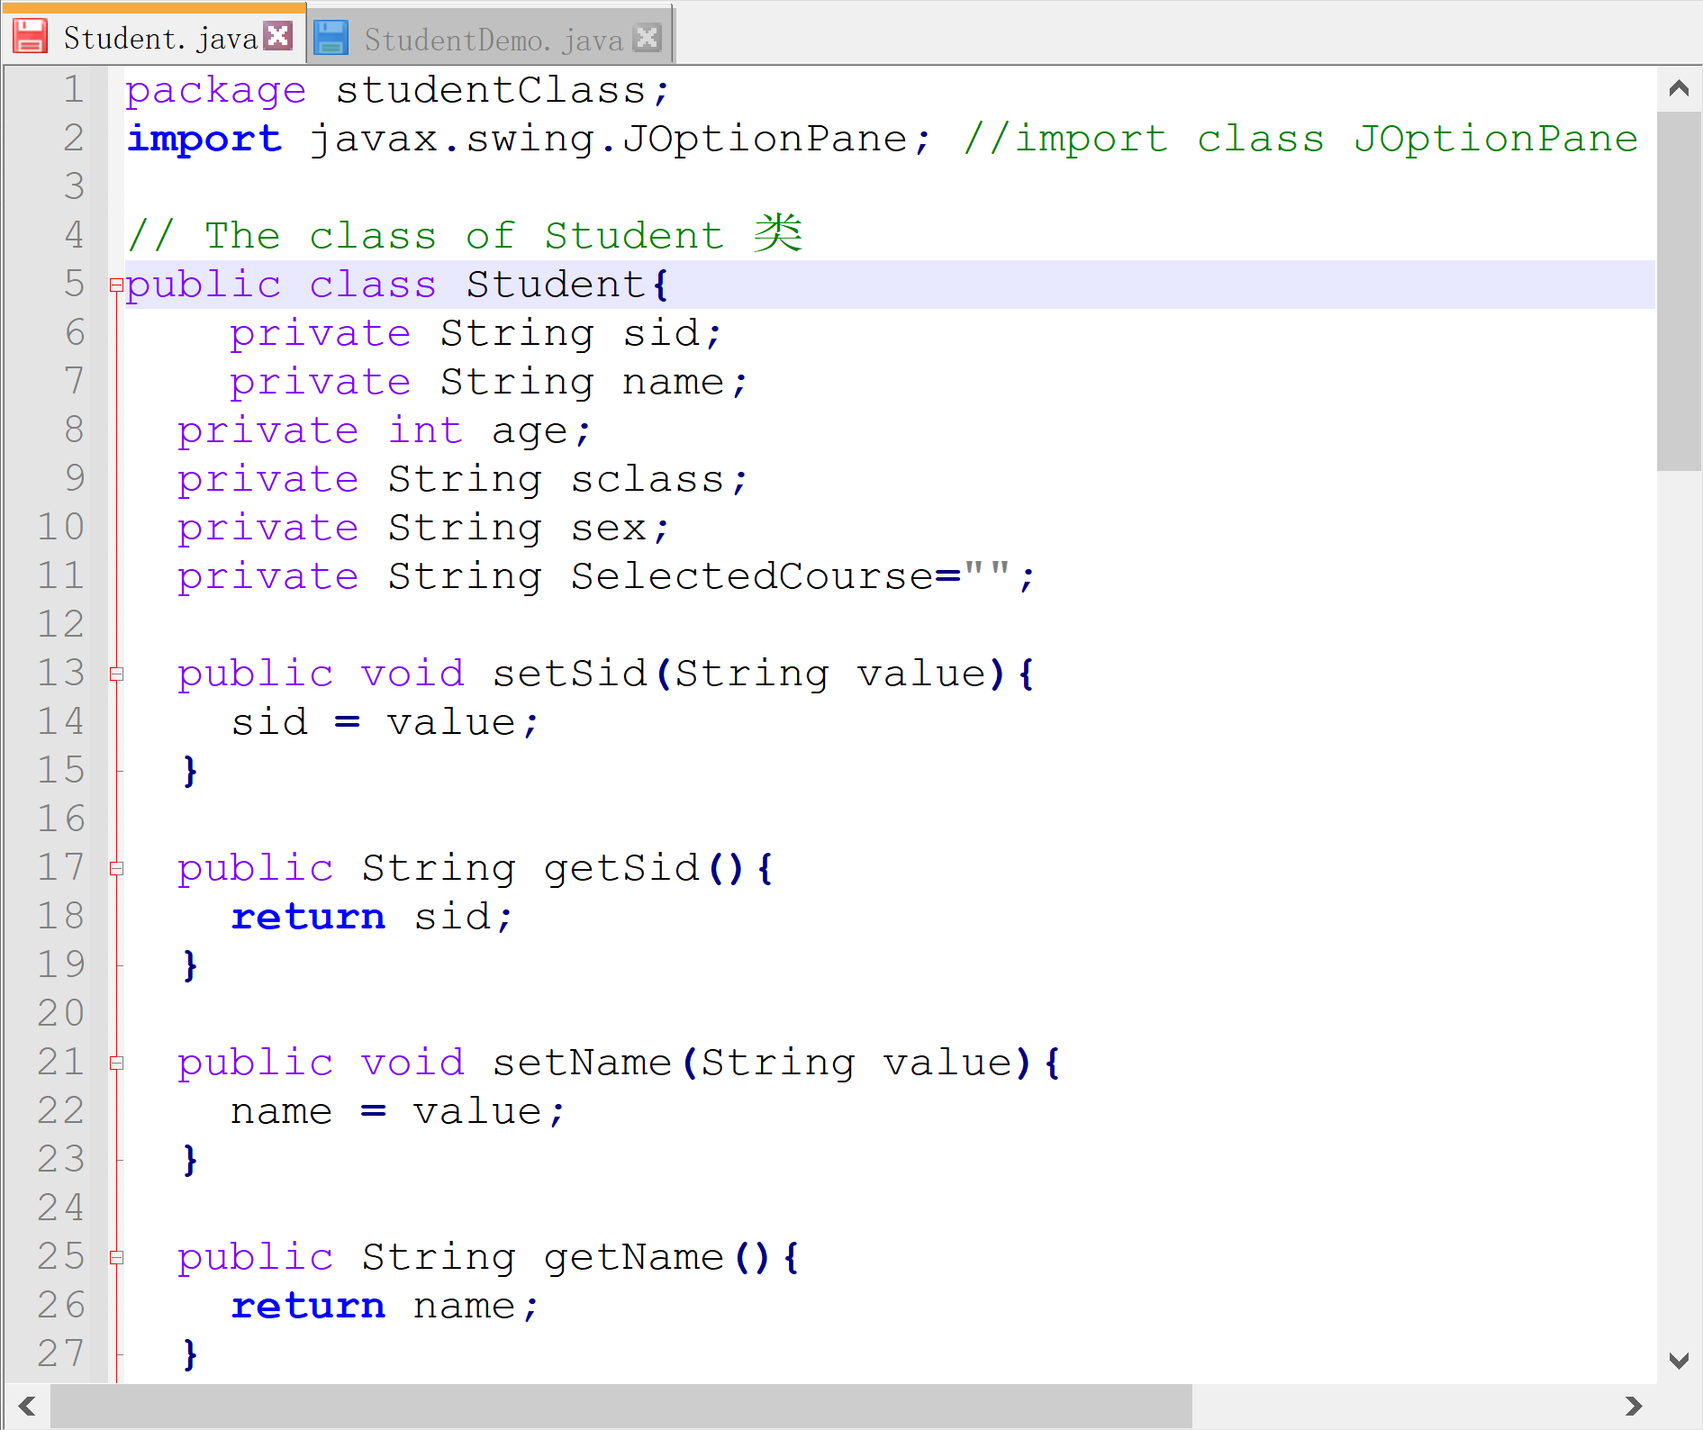
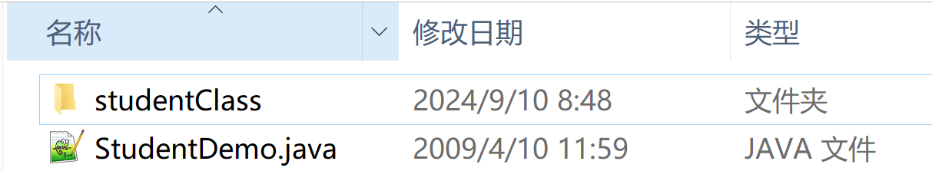

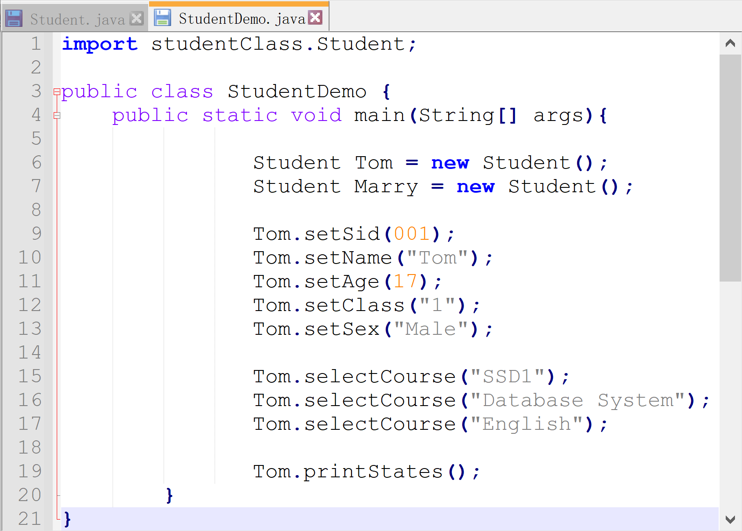
Package 示例
Notes:
Explain how packages and classes are related to one another.
Make sure students understand that packages are a higher level of abstraction than a class.
Everything in your model must reside in a package. Therefore, it is assumed that, at the top level of your model, there is one owning package.

Slide 62
面向对象方法的步骤
面向对象分析
  Object Oriented Analysis, OOA
面向对象设计
  Object Oriented Design, OOD
面向对象编程
  Object Oriented Programming, OOP
面向对象测试
  Object Oriented Testing, OOT

